Slide 1
Unit-V
Relational Database Design
Contents:
Pitfalls in Relational-Database Designs, Concept of Normalization, Functional Dependencies, First Normal Form, 2NF, 3NF, BCNF.
Transactions Management and Concurrency: Transaction Concept, Transaction States, ACID Properties, Concurrent Executions, Serializability – Conflict and View, Concurrency Control: Lock-Based, Timestamp-Based Protocols.
Recovery System: Introduction to Recovery System.

Slide 2
Course Objective:
To apply normalization techniques to normalize the database.
To understand the needs of database processing and learn techniques for controlling the consequences of concurrent data access.
Course Outcome:
Analyze and apply concepts of normalization to relational database design and explain the concept of transaction, concurrency and recovery.

Slide 3
Pitfalls / Drawbacks in Relational Database Design
The right database design will give less trouble during deployment, development, and performance.
Poor Design / Planning
The database is a vital aspect of every custom software, hence taking the time to map out the goals of database design ensures the success of any project. Consequences of lack of planning are seen further down the line and impacts projects in terms of time management.
Improper planning of the database leaves you with no time to go back and fix errors and leads to malicious cyber attacks. Therefore, consider sitting down with a paper and drawing a data model as per business requirements.
Developers can avoid poor planning/design by checking off the following points.
Main tables of your database model
Names for tables
Rules for naming tables
Time span required for the project

Slide 4
2. Ignoring Normalization
Normalization or SQL (Structured Query Language) groups data under a single table and indirectly related data are put under separate tables. These tables are connected with a logical relationship between child and parent tables.
Lack of normalization reduces data consistency and leads to duplication of data because entire data isn’t stored in one place.
Finding related data is difficult due to lack of grouping and costs time for searching. Hence, consider implementing normalization rules during database design.
Despite of normalization rules, databases don’t function as required. That’s because they need to be normalized to a third normal form.

Slide 5
3. Redundant Records
Redundancy in a database is a condition in which the same set of data is stored at two different places. This means two different spots or two separate fields in software. This is a problem for developers because they have to keep several versions of data updated.
Redundant records lead to unnecessary growth in database size, which in turn decreases the efficiency of the database and causes data corruption. Hence, the best option is to avoid preparing redundant records, unless it’s essential for backups.
Data redundancy is classified into two aspects – wasteful and excessive. Out of these, wasteful redundancy occurs when a set of data is repeated needlessly. Complicated data storing or inefficient coding results in wasteful redundancy.
For example, a table of students’ attributes includes a student name, student ID, college name, and course applied. Out of these, the values of college name and course are repeated which can cause issues such as insertion anomaly, update anomaly, and deletion anomaly.
To avoid redundant records, always delete data that is no longer needed.

Slide 6
4. Poor Naming Standards
Naming is a personal choice, however, it is an important aspect of documentation.
Poor naming standards result in messy and large data files, hence consider incorporating consistency.
The purpose of naming is to allow all future developers or programmers to easily understand the components of databases and what was their use.
This saves time for developers and they need not go through documents to understand the meaning of a name.
There isn’t a universal guide to naming conventions, but it’s best to avoid bad naming practices. Here are examples of unsuccessful naming conventions that one must avoid.
Underscore_for_Word_Separation
Meaningless or Generic Names
ALL UPPER CASE (impacts reading, don’t allow to use camel case)

Slide 7
5. Lack of Documentation
As per a survey conducted, the second most challenging task faced by developers was poor technical documentation.
Lack of documentation leads to the loss of vital information or a tedious handover process to a new programmer.
Consider documenting everything you know from day one because any documentation is better than none. Well-organized documentation throughout the project helps to wrap up everything smoothly and in turn, helps build robust software.
The goal of documentation is to provide information to the support programmer to detect bugs and fix them. Documentation starts with naming columns, objects, and tables in a database model. A well-documented data model consists of solid names, definitions on columns, tables, relationships, and check and default constraints.

Slide 8
6. One Table to Hold All Domain Values
to prepare one table for all the same values. For example, you have a range of values for varied areas such as order status, account status, and payment status; each one of them with different values.
The first thought that comes to mind is to store all the values in one place because they are all status values. So, a table would look like –
1. Table or entity (order, account, and payment)
2. Key (1,2, or 3 for whole table/entity)
3. Value (pending, draft, paid, etc.)
This table looks simple, yet it comes with its own set of issues. This approach does not include referential integrity because there’s no simplified way to assure statuses that are applicable to a table are associated with that specific table.
For example, you can’t relate the primary key to the account table and make sure that only account statuses are chosen.
Hence, to avoid these hassle

Slide 9
7. Ignoring Frequency or Purpose of the Data
By ignoring the fundamental purpose of data, a designer shifts away from the primary goal of storing and retrieving data efficiently when needed.
Lack of purpose of data results in no knowledge of what the data represents, at what rate and how it is going to be acquired, what will be the operational volume, and how to use it.
For instance, a system where data is collected each day manually will not have the same data model where information is created in real-time. That’s because managing a few thousand of data monthly is different as compared to handling millions of them in the same time period.
Further, data volume is not the only facet to consider because the purpose of data impacts data structure, normalization, implementation, and record size of the entire system.
Clarity of purpose helps to develop database designs, record size, create entities, choose database engine management policies, and formats. By ignoring these, designs will be flawed fundamentally, even though they are mathematically and structurally right.

Slide 10
8. Insufficient Indexing
Indexing is a data structure technique which allows you to quickly retrieve records from a database file
Insufficient indexing comes from a SQL configuration whose performance is affected due to improper, excessive, or missing indexes. In case indexes aren’t created properly, the SQL server goes through more records to retrieve the data that’s requested by the query.
A wrong index does not offer easy data manipulation and an index developed on multiple columns slows down queries instead of speeding them up. The lack of a clustered index in a table is a form of poor indexing. Execution of inserting, SELECT statement, deleting, and updating records is slower than on a clustered index.
Index efficiency is connected to the column type, for instance, indexes on INT column display the best performance, however, indexes on DATE, VARCHAR, or DECIMAL aren’t as efficient. This leads to redesigning tables with the best possible efficiency.
Overall, indexing is a complex decision because too much indexing is bad as little indexing, as it impacts the final outcome.

Slide 11
9. Lack of Testing
The lack of database testing fails to give information on whether the data values stored and received in the database are valid or not.
Testing helps to save transaction data, avoids data loss, and prevents unauthorized access to information.
The database is essential for every type of software application, therefore testers need to know about SQL during testing. Consider testing for a banking application, and during tests a few things to note are:
1. No loss of information during the process.
2. Application stores transaction data correctly in the database and displays it accurately.
3. No aborted or partial operation data is saved by the application.
So, these were the nine common pitfalls to avoid during database design. For developers, creating a neat and tight database structure is essential for a seamless project flow.

Slide 12
Concept of Normalization
It is a technique to reduce or remove redundancy from a table.
Normalization is the process of organizing data in a database. This includes creating tables and establishing relationships between those tables according to rules designed both to protect the data and to make the database more flexible by eliminating redundancy and inconsistent dependency.

Slide 13
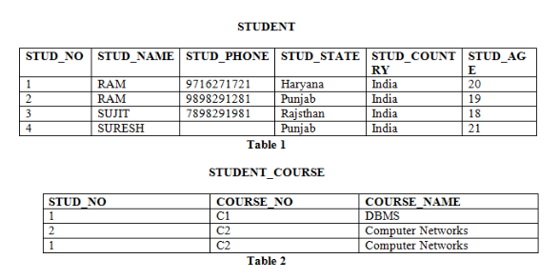
Anomalies/ Irregularities in Relational Model
There are different types of anomalies which can occur in referencing and referenced relation

Slide 14
Insertion anomaly: If a tuple is inserted in referencing relation and referencing attribute value is not present in referenced attribute, it will not allow inserting in referencing relation. For Example, If we try to insert a record in STUDENT_COURSE with STUD_NO =7, it will not allow.
Deletion and Updation anomaly: If a tuple is deleted or updated from referenced relation and referenced attribute value is used by referencing attribute in referencing relation, it will not allow deleting the tuple from referenced relation. For Example, If we try to delete a record from STUDENT with STUD_NO =1, it will not allow. To avoid this, following can be used in query:
ON DELETE/UPDATE SET NULL: If a tuple is deleted or updated from referenced relation and referenced attribute value is used by referencing attribute in referencing relation, it will delete/update the tuple from referenced relation and set the value of referencing attribute to NULL.
ON DELETE/UPDATE CASCADE: If a tuple is deleted or updated from referenced relation and referenced attribute value is used by referencing attribute in referencing relation, it will delete/update the tuple from referenced relation and referencing relation as well.

Slide 15
Player_no | Name | city | Game_no | G_name
11 | Smita | Pune | 1 | basketball
11 | Smita | Pune | 2 | Volleyball
12 | Shirish | Pune | 3 | Cricket
13 | Sanjiv | Mumbai | 1 | Basketball
13 | Sanjiv | Mumbai | 3 | Cricket
14 | Mandar | Nashik | 4 | Skating
15 | Mahesh | Solapur | 2 | Volleyball

Slide 16
Insertion of record -
When we try to insert record for the player. So we have to add the information of game also or vice a versa.
Player_no | Name | city | Game_no | G_name
17 | Smita | Nashik
 |  |  | 6 | Badminton

Slide 17
Deletion of record -
This anomaly happens when deletion of a data record result in losing some unrelated information that was stored as a part of record that was deleted from a table
Player_no | Name | city | Game_no | G_name
14 | Mandar | Nashik | 4 | Skating

Slide 18
Modification of record -
If modification do not occur at all places then database will be in inconsistent state.
Player_no | Name | city | Game_no | G_name
11 | Smita | Pune | 1 | Basketball
11 | Smita | Pune | 2 | Volleyball

Slide 19
Functional Dependency
The functional dependency is a relationship that exists between two attributes.
a relationship that is present between attributes of any table that are dependent on each other.
It helps in avoiding data redundancy and getting to know more about bad designs.
It typically exists between the primary key and non-key attribute within a table.
X → Y
The left side of FD is known as a determinant (main attribute), the right side of the production is known as a dependent (dependent attribute).
The values of the X component of a tuple uniquely (or functionally) determine the values of the Y component. We also say that there is a functional dependency from X to Y, or that Y is functionally dependent on X.
X determines Y. Or Y is determined by X.

Slide 20
X → Y
The left side of FD is known as a determinant, the right side of the production is known as a dependent.
For example:
Assume we have an employee table with attributes: Emp_Id, Emp_Name, Emp_Address
Here Emp_Id attribute can uniquely identify the Emp_Name attribute of employee table because if we know the Emp_Id, we can tell that employee name associated with it.
Functional dependency can be written as:
Emp_Id → Emp_Name
We can say that Emp_Name is functionally dependent on Emp_Id.

Slide 21
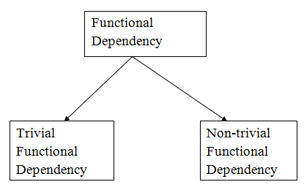
Types of Functional dependency

Slide 22
1. Trivial functional dependency
A → B has trivial functional dependency if B is a subset of A.
The following dependencies are also trivial like: A → A, B → B
always valid
L.H.S Intersection R.H.S. =! Null
Example:
Consider a table with two columns Employee_Id and Employee_Name.
{Employee_id, Employee_Name} → Employee_Id is a trivial functional dependency as
Employee_Id is a subset of {Employee_Id, Employee_Name}.
Employee_Id → Employee_Id and Employee_Name → Employee_Name are trivial dependencies too.

Slide 23
2. Non-trivial functional dependency
A → B has a non-trivial functional dependency if B is not a subset of A.
When A intersection B is NULL, then A → B is called as complete non-trivial.
L.H.S Intersection R.H.S. = Null
Example:
ID → Name,
Name → DOB

Slide 24
3. Semi Non Trivial Functional Dependencies
X → Y is called semi non-trivial when X intersect Y is not NULL.
Examples: AB → BC
AD → DC

Slide 25
Database Normal Forms
Here is a list of Normal Forms in SQL:
1NF (First Normal Form)
2NF (Second Normal Form)
3NF (Third Normal Form)
BCNF (Boyce-Codd Normal Form)
4NF (Fourth Normal Form)
5NF (Fifth Normal Form)
6NF (Sixth Normal Form)

Slide 26
Normalization is the process of minimizing redundancy from a relation or set of relations. Redundancy in relation may cause insertion, deletion, and update anomalies. So, it helps to minimize the redundancy in relations. Normal forms are used to eliminate or reduce redundancy in database tables.
1. First Normal Form –
Each table cell should contain a single value.
Each record needs to be unique.
If a relation contain composite or multi-valued attribute, it violates first normal form
A relation is in first normal form if it does not contain any composite or multi-valued attribute. A relation is in first normal form if every attribute in that relation is singled valued attribute.

Slide 27
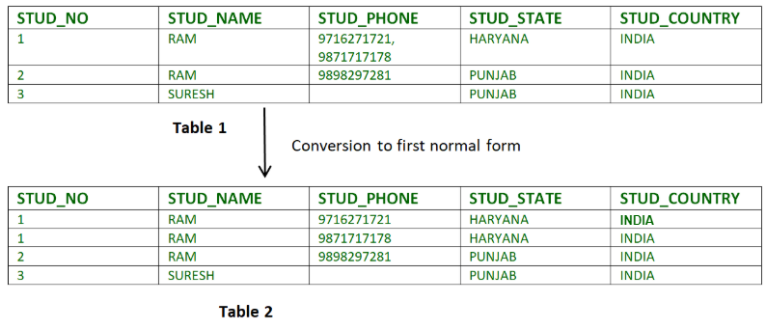
Example 1 – Relation STUDENT in table 1 is not in 1NF because of multi-valued attribute STUD_PHONE. Its decomposition into 1NF has been shown in table 2.

Slide 28
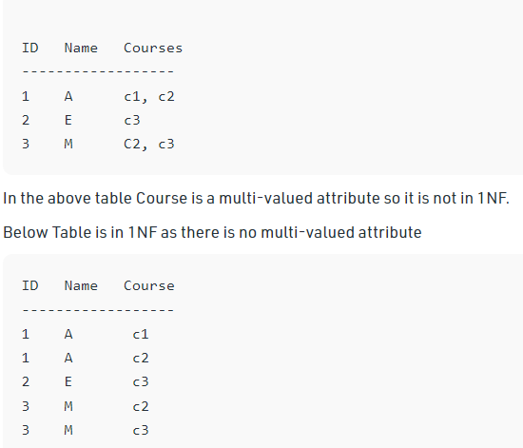
3 ways of representation into First normal form.
Not in 1NF
First way- recommended
Here {ID, Course} will be the Composite Primary key.

Slide 29
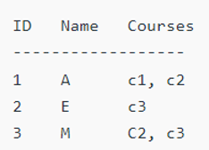
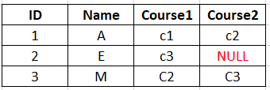
Second way- but not recommended
Here {ID} will be the Composite Primary key.

Slide 30
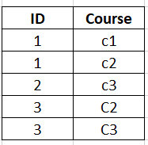
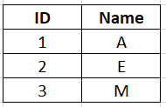
Third way
Secondary / Child / Referencing table
Primary / Base / Parent / Referenced table
{ID} will be the Foreign key and {ID, Course} will be Primary key
{ID} will be the Primary key.

Slide 31
2. Second Normal Form –
Rule 1- Be in 1NF
Rule 2- Single Column Primary Key that does not functionally dependent on any subset of candidate key relation
All the non-prime attributes should be fully functional dependent on candidate key
Non prime attribute- The attribute which are not participating in the formation of candidate key
To be in second normal form, a relation must be in first normal form and relation must not contain any partial dependency.
A relation is in 2NF if it has No Partial Dependency, i.e., no non-prime attribute (attributes which are not part of any candidate key) is dependent on any proper subset of any candidate key of the table.
Partial Dependency – If the proper subset of candidate key determines non-prime attribute, it is called partial dependency.

Slide 32
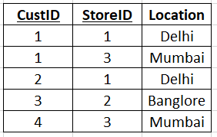
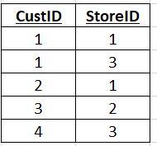
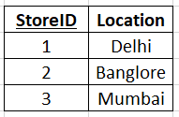
Not in 2NF
Candidate Key: {CustID, StoreID}
Primary Attribute: CustID, StoreID
Non prime attribute: Location
Here StoreID is determining location
Location is determined by StoreID
{StoreID} will be the Primary key and Location is determined by StoreID.
{CustID, StoreID} will be the Composite Primary key

Slide 33
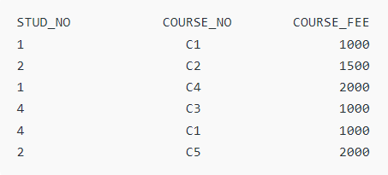
Not in 2NF
{Note that, there are many courses having the same course fee. }
COURSE_FEE cannot alone decide the value of COURSE_NO or STUD_NO; COURSE_FEE together with STUD_NO cannot decide the value of COURSE_NO; COURSE_FEE together with COURSE_NO cannot decide the value of STUD_NO; Hence, COURSE_FEE would be a non-prime attribute, as it does not belong to the one only candidate key {STUD_NO, COURSE_NO} ; But, COURSE_NO -> COURSE_FEE, i.e., COURSE_FEE is dependent on COURSE_NO, which is a proper subset of the candidate key. Non-prime attribute COURSE_FEE is dependent on a proper subset of the candidate key, which is a partial dependency and so this relation is not in 2NF.

Slide 34
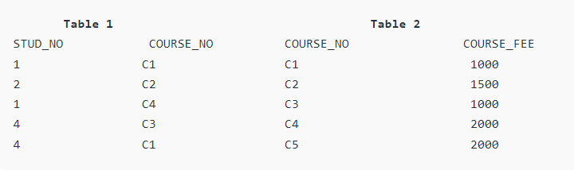
To convert the above relation to 2NF, we need to split the table into two tables such as : Table 1: STUD_NO, COURSE_NO Table 2: COURSE_NO, COURSE_FEE
NOTE: 2NF tries to reduce the redundant data getting stored in memory. For instance, if there are 100 students taking C1 course, we don’t need to store its Fee as 1000 for all the 100 records, instead, once we can store it in the second table as the course fee for C1 is 1000.

Slide 35
3NF (Third Normal Form) Rules
Rule 1- Be in 2NF
Rule 2- Has no transitive functional dependencies in the table
To move our 2NF table into 3NF, we again need to again divide our table.
For each FD= LHS must be a Candidate key or Super key or RHS is a prime attribute.
Advantage of removing Transitive Dependency
Amount of data duplication is reduced.
Data integrity achieved.

Slide 36
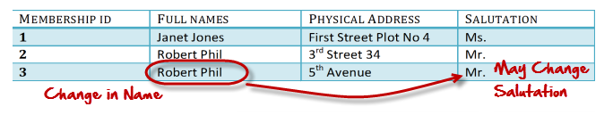
What are transitive functional dependencies?
A transitive functional dependency is when changing a non-key column, might cause any of the other non-key columns to change
Consider the table Changing the non-key column Full Name may change Salutation.
FD: MembershipID -> FullName
{MembershipID} is the Primary key or Prime Attribute
Non-Prime attributes= Full Name, Address, Salutation
But FullName -> salutation
Transitivity: MembershipID -> FullName -> salutation

Slide 37
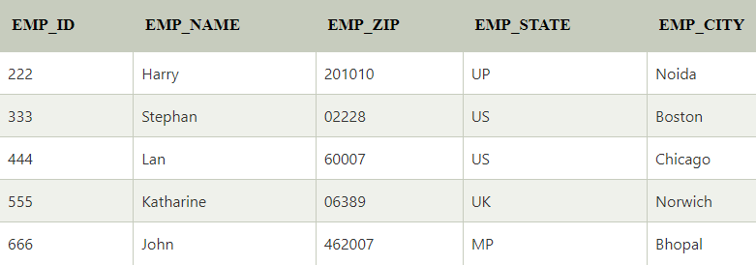
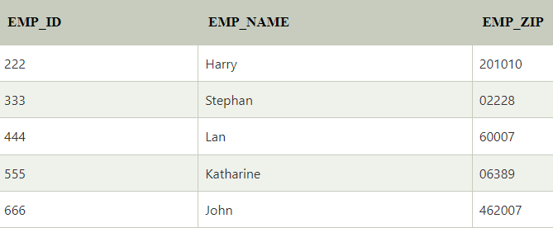
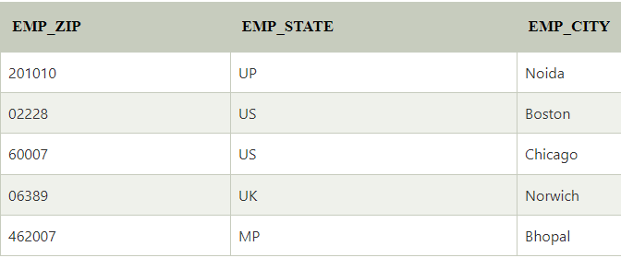
Candidate key: {EMP_ID} : Prime attribute
EMP_ID -> EMP_ZIP
EMP_ZIP -> EMP_STATE
EMP_ZIP -> EMP_CITY
Non-prime attributes: In the given table, all attributes except EMP_ID are non-prime.
Here, EMP_STATE & EMP_CITY dependent on EMP_ZIP and EMP_ZIP dependent on EMP_ID. The non-prime attributes (EMP_STATE, EMP_CITY) transitively dependent on super key(EMP_ID). It violates the rule of third normal form.
That's why we need to move the EMP_CITY and EMP_STATE to the new <EMPLOYEE_ZIP> table, with EMP_ZIP as a Primary key.

Slide 38
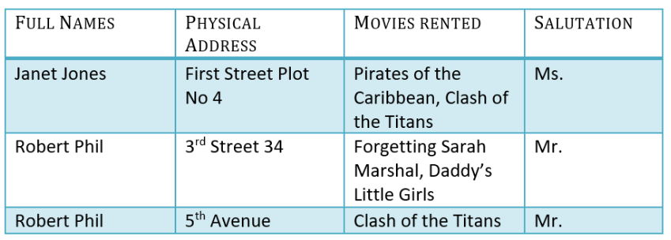
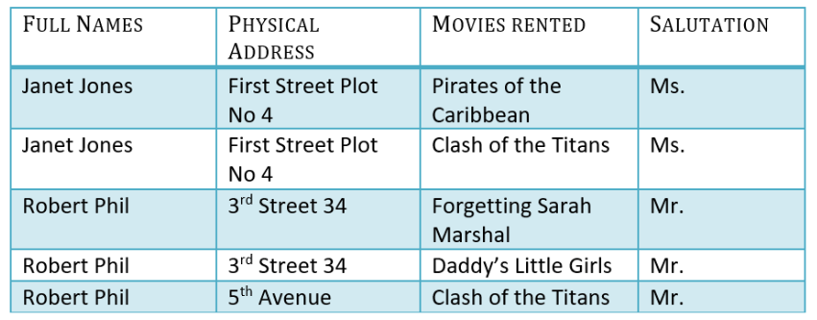
Original Table- not normalized
Table in 1NF

Slide 39
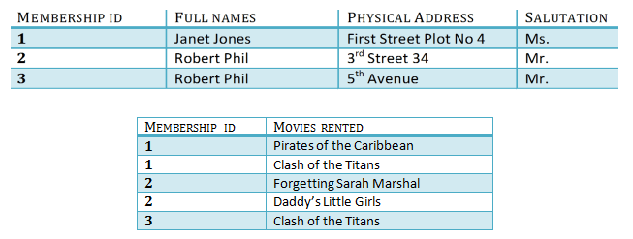
Table is in 2NF

Slide 40
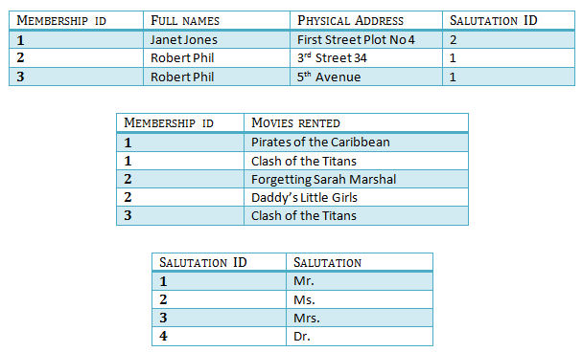
We have again divided our tables and created a new table which stores Salutations.
There are no transitive functional dependencies, and hence our table is in 3NF
In Table 3 Salutation ID is primary key, and in Table 1 Salutation ID is foreign to primary key in Table 3
Salutation ID is foreign key
Salutation ID is primary key

Slide 41
Boyce Codd normal form (BCNF)
BCNF is the advance version of 3NF.
It is stricter than 3NF.
LHS of each functional dependency should be candidate key or super key.
A table is in BCNF if every functional dependency X → Y, X is the super key of the table.
For BCNF, the table should be in 3NF, and for every FD, LHS is super key.
Example: Let's assume there is a company where employees work in more than one department.

Slide 42
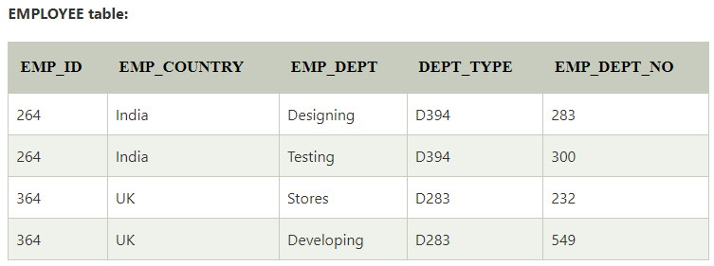
In the above table Functional dependencies are as follows:
EMP_ID → EMP_COUNTRY
EMP_DEPT → {DEPT_TYPE, EMP_DEPT_NO}
Candidate key: {EMP-ID, EMP-DEPT}
The table is not in BCNF because neither EMP_DEPT nor EMP_ID alone are keys.
To convert the given table into BCNF, we decompose it into three tables:

Slide 43
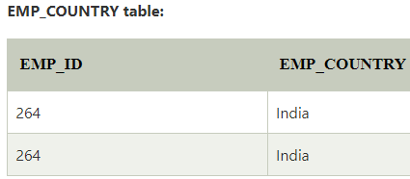
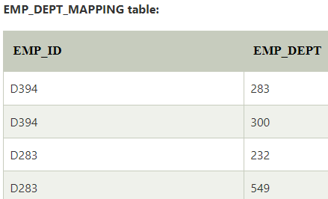
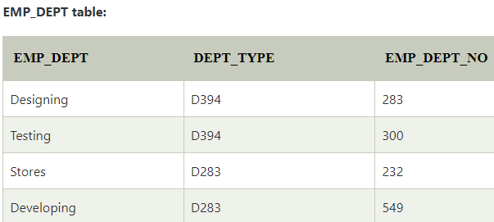
Original Table Decomposed into 3 tables to convert it into BCNF
Table: 1
Table: 3
Table:2

Slide 44
Functional dependencies:
EMP_ID → EMP_COUNTRY
EMP_DEPT → {DEPT_TYPE, EMP_DEPT_NO}
Candidate keys:
For the first table: EMP_ID For the second table: EMP_DEPT For the third table: {EMP_ID, EMP_DEPT}
Now, this is in BCNF because left side part of both the functional dependencies is a key.

Slide 45
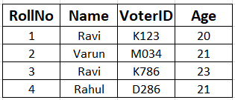
Example 2
Student Table
Candidate Key: { RollNo, VoterID }
FD: Rollno name
Rollno VoterID
VoterID age
VoterID Rollno

Slide 46
Note:
BCNF decomposition does not always satisfy dependency preserving property.
After BCNF decomposition if dependency is not preserved then we have to decide whether we want to remain in BCNF or rollback to 3NF. This process of rollback is called Denormalization.

Slide 47
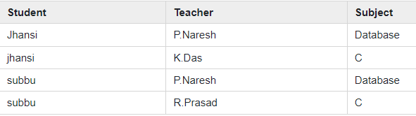
F: { (student, Teacher) -> subject
(student, subject) -> Teacher
Teacher -> subject}
Candidate keys are (student, teacher) and (student, subject).
The above relation is in 3NF [since there is no transitive dependency].
A relation R is in BCNF if for every non-trivial FD: X->Y, X must be a key.
The above relation is not in BCNF, because in the FD (teacher->subject), teacher is not a key.

Slide 48
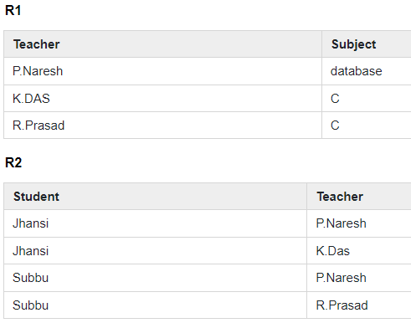
Decomposition for BCNF
Teacher-> subject violates BCNF [since teacher is not a candidate key].
If X->Y violates BCNF then divide R into R1(X, Y) and R2(R-Y).
So R is divided into two relations R1(Teacher, subject) and R2(student, Teacher).

Slide 49
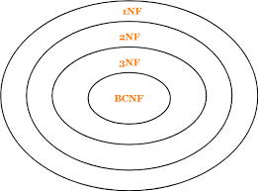

Slide 50
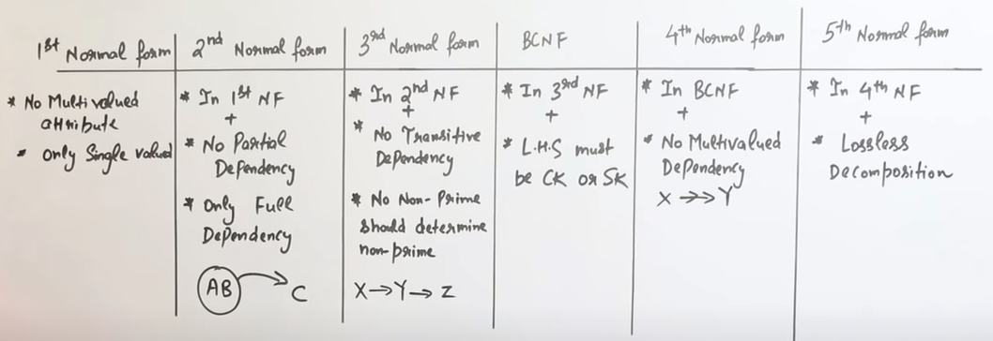

Slide 51
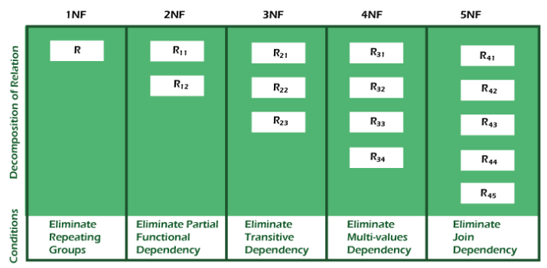

Slide 52
Contents:
Transactions Management and Concurrency:
Transaction Concept,
Transaction States,
ACID Properties,
Concurrent Executions,
Serializability – Conflict and View,
Concurrency Control: Lock-Based, Timestamp-Based Protocols.

Slide 53
Transaction
The transaction is a set of logically related operations. It contains a group of tasks.
Set of operations used to perform a logical unit if work.
It generally represent change in database.
A transaction is an action or series of actions. It is performed by a single user to perform operations for accessing the contents of the database.

Slide 54
Example: Suppose an employee of bank transfers Rs 800 from X's account to Y's account.
This small transaction contains several low-level tasks.
X's Account
Open_Account(X)
Old_Balance = X.balance
New_Balance = Old_Balance - 800
X.balance = New_Balance
Close_Account(X)
Y's Account
Open_Account(Y)
Old_Balance = Y.balance
New_Balance = Old_Balance + 800
Y.balance = New_Balance
Close_Account(Y)

Slide 55
ATM transaction steps
Transaction Start.
Insert your ATM card.
Select language for your transaction.
Select Savings Account option.
Enter the amount you want to withdraw.
Enter your secret pin.
Wait for some time for processing.
Collect your Cash.
Transaction Completed.
Three operations can be performed in a transaction as follows. 1. Read/Access data (R).
2. Write/Change data (W). 3. Commit.

Slide 56
Transfer of 50₹ from Account A to Account B. Initially A= 500₹, B= 800₹.
This data is brought to RAM from Hard Disk.
R(A) -- 500 // Accessed from RAM.
A = A-50 // Deducting 50₹ from A.
W(A)--450 // Updated in RAM.
R(B) -- 800 // Accessed from RAM.
B=B+50 // 50₹ is added to B's Account.
W(B) --850 // Updated in RAM.
commit // The data in RAM is taken back to Hard Disk.

Slide 57
Operations of Transaction:
begin_transaction − A marker that specifies start of transaction execution.
read_item or write_item − Database operations that may be interleaved with main memory operations as a part of transaction.
end_transaction − A marker that specifies end of transaction.
commit − A signal to specify that the transaction has been successfully completed in its entirety and will not be undone.
rollback − A signal to specify that the transaction has been unsuccessful and so all temporary changes in the database are undone. A committed transaction cannot be rolled back.

Slide 58
Operations of Transaction: Following are the main operations of transaction
Read(X):
Read operation is used to read the value of X from the database and stores it in a buffer in main memory. Give the access of database.
Read operation reads the data from the database and then stores it in the buffer in main memory.
Write(X):
Write operation is used to write the value back to the database from the buffer. Change in database.
Write operation writes the updated data value back to the database from the buffer.
For example- Write(A) will write the updated value of A from the buffer to the database.

Slide 59
Let's take an example to debit transaction from an account which consists of following operations:
1. R(X);
2. X = X - 500;
3. W(X);
Let's assume the value of X before starting of the transaction is 4000.
The first operation reads X's value from database and stores it in a buffer.
The second operation will decrease the value of X by 500. So buffer will contain 3500.
The third operation will write the buffer's value to the database. So X's final value will be 3500.
But it may be possible that because of the failure of hardware, software or power, etc. that transaction may fail before finished all the operations in the set.

Slide 60
For example:
If in the above transaction, the debit transaction fails after executing operation 2 then X's value will remain 4000 in the database which is not acceptable by the bank.
To solve this problem, we have two important operations:
Commit: It is used to save the work done permanently.
Rollback: It is used to undo the work done.

Slide 61
Uses of Transaction Management :
The DBMS is used to schedule the access of data concurrently. It means that the user can access multiple data from the database without being interfered with each other. Transactions are used to manage concurrency.
It is also used to satisfy ACID properties.
It is used to solve Read/ Write Conflict.
It is used to implement Recoverability, Serializability, and Cascading.
Transaction Management is also used for Concurrency Control Protocols and Locking of data.
Disadvantage of using a Transaction :
It may be difficult to change the information within the transaction database by end-users.
We need to always roll back and start from the beginning rather than continue from the previous state.

Slide 62
CPU
Cache Memory
Hard Disk

Slide 63
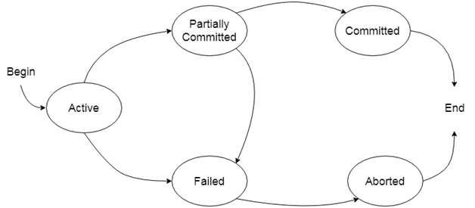
States of Transaction
In a database, the transaction can be in one of the following states-

Slide 64
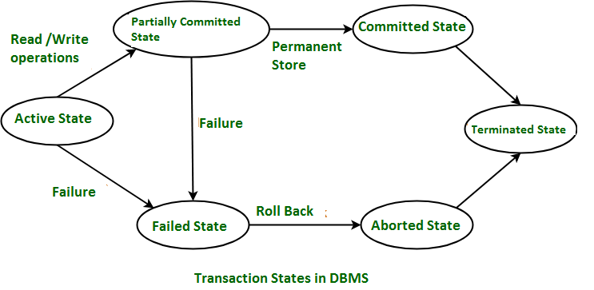

RAM
Hard Disk
Commit
RAM
Free Resources
CPU, RAM, Registers
RAM
Kill or Restart

Slide 65
1. Active state
The active state is the first state of every transaction.
In this state, the transaction is being executed.
When the instructions of the transaction are running then the transaction is in active state. If all the ‘read and write’ operations are performed without any error then it goes to the “partially committed state”; if any instruction fails, it goes to the “failed state”.
For example: Insertion or deletion or updating a record is done here. But all the records are still not saved to the database.

Slide 66
2. Partially committed
In the partially committed state, a transaction executes its final operation, but the data is still not saved to the database.
After completion of all the read and write operation the changes are made in main memory or local buffer. If the changes are made permanent on the DataBase then the state will change to “committed state” and in case of failure it will go to the “failed state”.
In the total mark calculation example, a final display of the total marks step is executed in this state.

Slide 67
3. Committed
A transaction is said to be in a committed state if it executes all its operations successfully.
In this state, all the effects are now permanently saved on the database system.
It is the state when the changes are made permanent on the Data Base and the transaction is complete and therefore terminated in the “terminated state”.
4. Failed state
If any of the checks made by the database recovery system fails, then the transaction is said to be in the failed state.
When any instruction of the transaction fails, it goes to the “failed state” or if failure occurs in making a permanent change of data on Data Base.
In the example of total mark calculation, if the database is not able to fire a query to fetch the marks, then the transaction will fail to execute.

Slide 68
5. Aborted state
If any of the checks fail and the transaction has reached a failed state then the database recovery system will make sure that the database is in its previous consistent state. If not then it will abort or roll back the transaction to bring the database into a consistent state.
If the transaction fails in the middle of the transaction then before executing the transaction, all the executed transactions are rolled back to its consistent state.
After having any type of failure the transaction goes from “failed state” to “aborted state” and since in previous states, the changes are only made to local buffer or main memory and hence these changes are deleted or rolled-back.
After aborting the transaction, the database recovery module will select one of the two operations:
Re-start the transaction
Kill the transaction

Slide 69
6. Terminated State –
If there isn’t any roll-back or the transaction comes from the “committed state”, then the system is consistent and ready for new transaction and the old transaction is terminated.

Slide 70
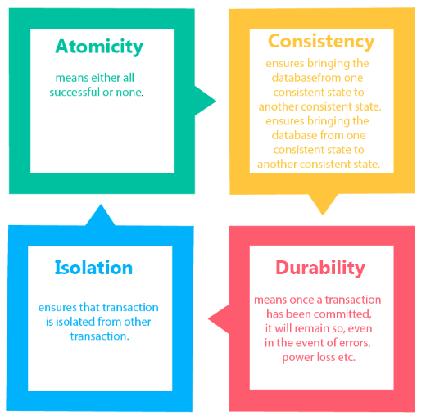
Transaction properties
The transaction has the four properties. These are used to maintain consistency in a database, before and after the transaction.
Property of Transaction
Atomicity
Consistency
Isolation
Durability

Slide 71
1. Atomicity
Either all or none
It states that all operations of the transaction take place at once if not, the transaction is aborted.
There is no midway, i.e., the transaction cannot occur partially.
Each transaction is treated as one unit and either run to completion or is not executed at all.
A failed transaction can not be resumed.
A failed transaction can always restart.
Atomicity involves the following two operations:
Abort: If a transaction aborts then all the changes made are not visible.
Commit: If a transaction commits then all the changes made are visible.

Slide 72
Example: Let's assume that following transaction T consisting of T1 and T2. A consists of Rs 600 and B consists of Rs 300. Transfer Rs 100 from account A to account B.
After completion of the transaction, A consists of Rs 500 and B consists of Rs 400.
If the transaction T fails after the completion of transaction T1 but before completion of transaction T2, then the amount will be deducted from A but not added to B. This shows the inconsistent database state. In order to ensure correctness of database state, the transaction must be executed in entirety.
T1 | T2
Read(A) A:= A-100 Write(A) | Read(B) Y:= Y+100 Write(B)

Slide 73
2. Consistency
The integrity constraints are maintained so that the database is consistent before and after the transaction.
The execution of a transaction will leave a database in either its prior stable state or a new stable state.
The consistent property of database states that every transaction sees a consistent database instance.
The transaction is used to transform the database from one consistent state to another consistent state.
Before transaction starts and after transaction completed sum of money should be same.
For example: The total amount must be maintained before or after the transaction.
Total before T occurs = 600+300=900
Total after T occurs= 500+400=900
Therefore, the database is consistent. In the case when T1 is completed but T2 fails, then inconsistency will occur.

Slide 74
3. Isolation
Parallel transaction
It shows that the data which is used at the time of execution of a transaction cannot be used by the second transaction until the first one is completed.
In isolation, if the transaction T1 is being executed and using the data item X, then that data item can't be accessed by any other transaction T2 until the transaction T1 ends.
The concurrency control subsystem of the DBMS enforced the isolation property.
Convert parallel schedule to serial schedule.

Slide 75
4. Durability
The durability property is used to indicate the performance of the database's consistent state.
It states that the transaction made the permanent changes.
They cannot be lost by the erroneous operation of a faulty transaction or by the system failure.
When a transaction is completed, then the database reaches a state known as the consistent state. That consistent state cannot be lost, even in the event of a system's failure.
The recovery subsystem of the DBMS has the responsibility of Durability property.
Changes in the database should be permanent.

Slide 76
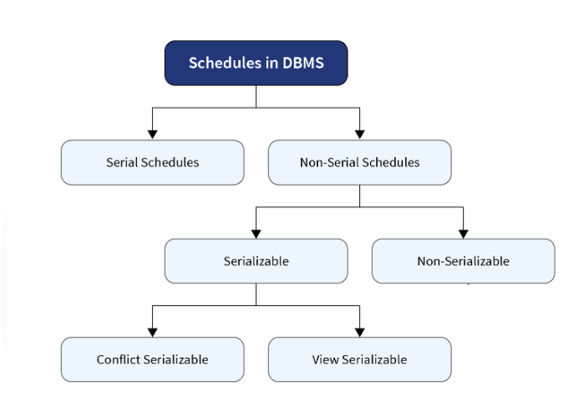

Slide 77
Schedule: Chronological execution sequence of multiple transactions. (collection of transactions)
2 types: serial and parallel
1. Serial: in queue. A schedule in which only one transaction is executed at a time, i.e., one transaction is executed completely before starting another transaction.
Example: ATM
Advantage: secure transaction, Consistency
Disadvantage: waiting time, degrade performance, less throughput (number of transactions executed per unit time)
2. Non serial /Parallel schedule (Concurrent Executions)- Switching between multiple transactions.
A schedule in which the transactions are interleaving or interchanging. There are several transactions executing simultaneously as they are being used in performing real-world database operations. These transactions may be working on the same piece of data. Hence, the serializability of non-serial schedules is a major concern so that our database is consistent before and after the execution of the transactions.
Advantage: high performance, high throughput, resource utilization, decrease waiting time

Slide 78
Concurrent Execution in DBMS / Non serial /Parallel schedule :
In a multi-user system, multiple users can access and use the same database at one time, which is known as the concurrent execution of the database. It means that the same database is executed simultaneously on a multi-user system by different users.
While working on the database transactions, there occurs the requirement of using the database by multiple users for performing different operations, and in that case, concurrent execution of the database is performed.
The thing is that the simultaneous execution that is performed should be done in an interleaved manner, and no operation should affect the other executing operations, thus maintaining the consistency of the database. Thus, on making the concurrent execution of the transaction operations, there occur several challenging problems that need to be solved.

Slide 79
Problems with Concurrent Execution
In a database transaction, the two main operations are READ and WRITE operations. So, there is a need to manage these two operations in the concurrent execution of the transactions as if these operations are not performed in an interleaved manner, and the data may become inconsistent.
When multiple transactions execute concurrently in an uncontrolled or unrestricted manner, then it might lead to several problems. These problems are commonly referred to as concurrency problems in a database environment.

Slide 80
The five concurrency problems that can occur in the database are:
Temporary Update Problem/ Dirty Read Problems / Uncommitted Read problem/ Read after Write Problem/ W-R Conflict
Incorrect Summary Problem
Lost Update Problem
Unrepeatable Read Problem / Inconsistent Retrievals Problem
Phantom Read Problem

Slide 81
1. Temporary Update Problem: Dirty Read Problems (W-R Conflict)
Temporary update or dirty read problem occurs when one transaction updates an item and fails. But the updated item is used by another transaction before the item is changed or reverted back to its last value.
The dirty read problem occurs when one transaction updates an item of the database, and somehow the transaction fails, and before the data gets rollback, the updated database item is accessed by another transaction. There comes the Read-Write Conflict between both transactions.
Example: In the example, if transaction 1 fails for some reason then X will revert back to its previous value. But transaction 2 has already read the incorrect value of X.

Slide 82
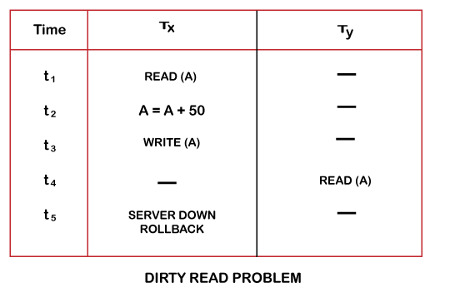
Temporary Update / Dirty Read Problem Example
At time t1, transaction T_{X} reads the value of account A, 300.
At time t2, transaction T_{X} adds 50 to account A that becomes 350.
At time t3, transaction T_{X} writes the updated value in account A, 350.
Then at time t4, transaction T_{Y} reads account A that will be read as 350.
Then at time t5, transaction T_{X} rollbacks due to server problem, and the value changes back to 300 (as initially).
But the value for account A remains 350 for transaction T_{Y} as committed, which is the dirty read and therefore known as the Dirty Read Problem.
available balance in account A is 300

Slide 83
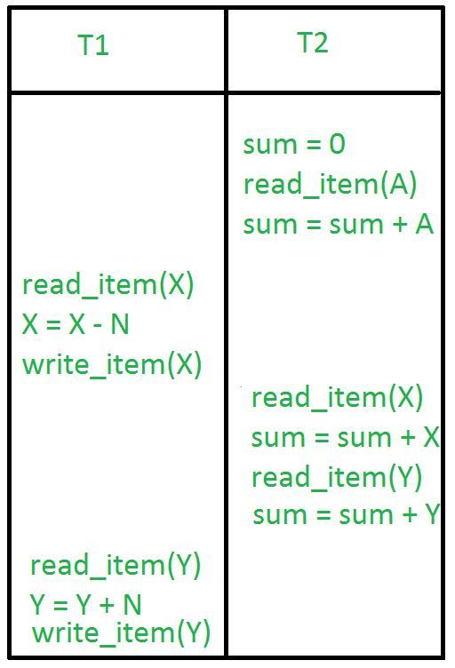
2. Incorrect Summary Problem:
Consider a situation, where one transaction is applying the aggregate function on some records while another transaction is updating these records. The aggregate function may calculate some values before the values have been updated and others after they are updated.
In the example, transaction 2 is calculating the sum of some records while transaction 1 is updating them.
Therefore the aggregate function may calculate some values before they have been updated and others after they have been updated.
A= 100, X = 200, Y= 300, N= 50

Slide 84
3. Lost Update Problem (W - W Conflict) :
In the lost update problem, an update done to a data item by a transaction is lost as it is overwritten by the update done by another transaction.
The problem occurs when two different database transactions perform the read/write operations on the same database items in an interleaved manner (i.e., concurrent execution) that makes the values of the items incorrect hence making the database inconsistent.
The write commit done by the last transaction will overwrite all previous write commits.

Slide 85
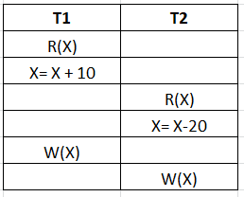
Lost Update Problem
available balance in account X is 100
Example:
transaction 1 changes the value of X but it will get overwritten by the write commit by transaction 2 on X).
Therefore, the update done by transaction 1 will be lost. Basically, the write commit done by the last transaction will overwrite all previous write commits.

Slide 86
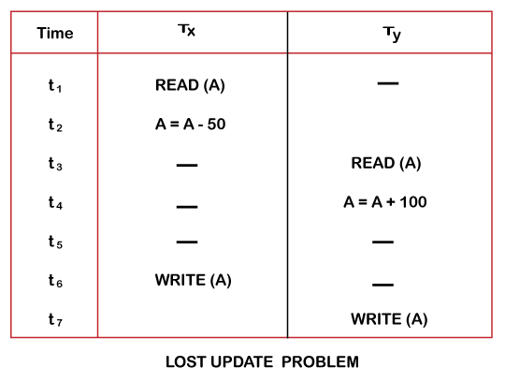
At time t1, transaction T_{X} reads the value of account A, 300 (only read).
At time t2, transaction T_{X} deducts 50 from account A that becomes 250 (only deducted and not updated/write).
Alternately, at time t3, transaction T_{Y} reads the value of account A that will be 300 only because T_{X} didn't update the value yet.
At time t4, transaction T_{Y} adds 100 to account A that becomes 400 (only added but not updated/write).
At time t6, transaction T_{X} writes the value of account A that will be updated as 250 only, as T_{Y} didn't update the value yet.
Similarly, at time t7, transaction T_{Y} writes the values of account A, so it will write as done at time t4 that will be 400. It means the value written by T_{X} is lost, 250 is lost.
Hence data becomes incorrect, and database sets to inconsistent.
balance of account A is 300

Slide 87
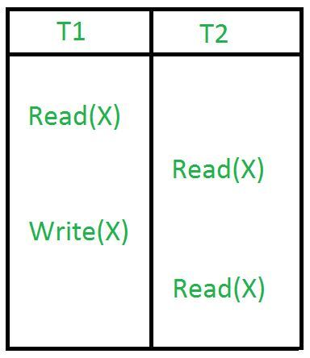
4. Unrepeatable Read Problem (W-R Conflict) :
The unrepeatable problem occurs when two or more read operations of the same transaction read different values of the same variable.
Also known as Inconsistent Retrievals Problem that occurs when in a transaction, two different values are read for the same database item.
once transaction 2 reads the variable X, a write operation in transaction 1 changes the value of the variable X. Thus, when another read operation is performed by transaction 2, it reads the new value of X which was updated by transaction 1.
X = X + 100

Slide 88
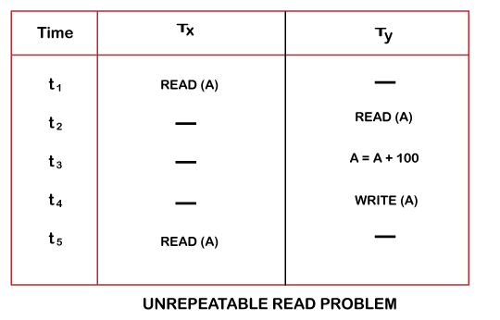
At time t1, transaction T_{X} reads the value from account A, 300.
At time t2, transaction T_{Y} reads the value from account A, 300.
At time t3, transaction T_{Y} updates the value of account A by adding $100 to the available balance, and then it becomes 400.
At time t4, transaction T_{Y} writes the updated value, 400.
After that, at time t5, transaction T_{X} reads the available value of account A, and that will be read as 400.
It means that within the same transaction T_{X}, it reads two different values of account A, 300 initially, and after updation made by transaction T_{Y}, it reads 400. It is an unrepeatable read and is therefore known as the Unrepeatable read problem.
available balance = 300

Slide 89
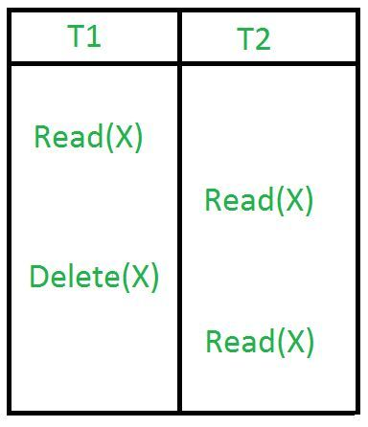
5. Phantom Read Problem:
The phantom read problem occurs when a transaction reads a variable once but when it tries to read that same variable again, an error occurs saying that the variable does not exist.
once transaction 2 reads the variable X, transaction 1 deletes the variable X without transaction 2’s knowledge. Thus, when transaction 2 tries to read X, it is not able to do it.

Slide 90
Concurrency Control
Concurrency Control is the working concept that is required for controlling and managing the concurrent execution of database operations and thus avoiding the inconsistencies in the database.
Thus, for maintaining the concurrency of the database, we have the concurrency control protocols.
The concurrency control protocols ensure the atomicity, consistency, isolation, durability and serializability of the concurrent execution of the database transactions.
Therefore, these protocols are categorized as:
Lock Based Concurrency Control Protocol
Time Stamp Based Concurrency Control Protocol
Validation Based Concurrency Control Protocol

Slide 91
1. Lock-Based Concurrency Control Protocol
In this type of protocol, any transaction cannot read or write data until it acquires an appropriate lock on it. There are two types of lock:
1. Shared lock / Read-only lock:
In a shared lock, the data item can only read by the transaction.
It can be shared between the transactions because when the transaction holds a lock, then it can't update the data on the data item.
2. Exclusive lock:
In the exclusive lock, the data item can be both reads as well as written by the transaction.
This lock is exclusive, and in this lock, multiple transactions do not modify the same data simultaneously.

Slide 92
There are four types of lock protocols available:
Simplistic lock protocol
Pre-claiming Lock Protocol
Two-phase locking (2PL)
Strict Two-phase locking (Strict-2PL)

Slide 93
1. Simplistic lock protocol
It is the simplest way of locking the data while transaction. Simplistic lock-based protocols allow all the transactions to get the lock on the data before insert or delete or update on it. It will unlock the data item after completing the transaction.

Slide 94
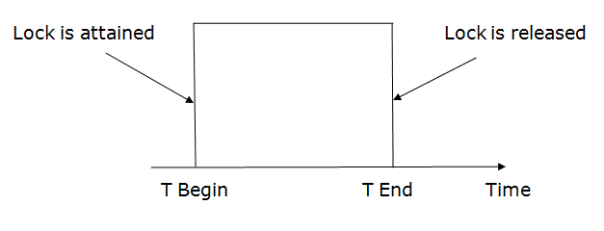
2. Pre-claiming Lock Protocol
Pre-claiming Lock Protocols evaluate the transaction to list all the data items on which they need locks.
Before initiating an execution of the transaction, it requests DBMS for all the lock on all those data items.
If all the locks are granted then this protocol allows the transaction to begin. When the transaction is completed then it releases all the lock.
If all the locks are not granted then this protocol allows the transaction to rolls back and waits until all the locks are granted.

Slide 95
3. Two-phase locking (2PL)
The two-phase locking protocol divides the execution phase of the transaction into three parts.
In the first part, when the execution of the transaction starts, it seeks permission for the lock it requires.
In the second part, the transaction acquires all the locks. The third phase is started as soon as the transaction releases its first lock.
In the third phase, the transaction cannot demand any new locks. It only releases the acquired locks.
There are two phases of 2PL:
Growing phase: In the growing phase, a new lock on the data item may be acquired by the transaction, but none can be released.
Shrinking phase: In the shrinking phase, existing lock held by the transaction may be released, but no new locks can be acquired.

Slide 96
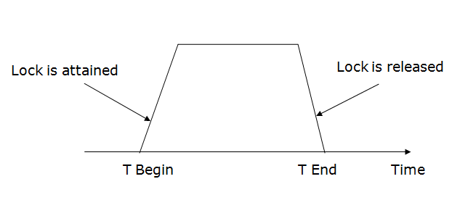

Slide 97
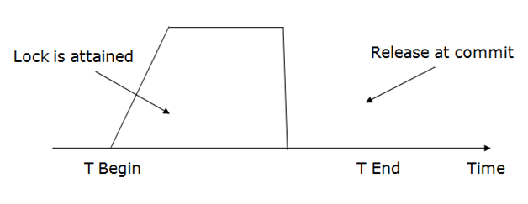
4. Strict Two-phase locking (Strict-2PL)
The first phase of Strict-2PL is similar to 2PL. In the first phase, after acquiring all the locks, the transaction continues to execute normally.
The only difference between 2PL and strict 2PL is that Strict-2PL does not release a lock after using it.
Strict-2PL waits until the whole transaction to commit, and then it releases all the locks at a time.
Strict-2PL protocol does not have shrinking phase of lock release.

Slide 98
2. Time Stamp Based Concurrency Control Protocol / Timestamp Ordering Protocol
The Timestamp Ordering Protocol is used to order the transactions based on their Timestamps. The order of transaction is nothing but the ascending order of the transaction creation.
The priority of the older transaction is higher that's why it executes first. To determine the timestamp of the transaction, this protocol uses system time or logical counter.
The lock-based protocol is used to manage the order between conflicting pairs among transactions at the execution time. But Timestamp based protocols start working as soon as a transaction is created.
Let's assume there are two transactions T1 and T2. Suppose the transaction T1 has entered the system at 007 times and transaction T2 has entered the system at 009 times. T1 has the higher priority, so it executes first as it is entered the system first.
The timestamp ordering protocol also maintains the timestamp of last 'read' and 'write' operation on a data.

Slide 99
Basic Timestamp ordering protocol works as follows:
1. Check the following condition whenever a transaction Ti issues a Read (X) operation:
If W_TS(X) >TS(Ti) then the operation is rejected.
If W_TS(X) <= TS(Ti) then the operation is executed.
Timestamps of all the data items are updated.
2. Check the following condition whenever a transaction Ti issues a Write(X) operation:
If TS(Ti) < R_TS(X) then the operation is rejected.
If TS(Ti) < W_TS(X) then the operation is rejected and Ti is rolled back otherwise the operation is executed.
Where,
TS(TI) denotes the timestamp of the transaction Ti.
R_TS(X) denotes the Read time-stamp of data-item X.
W_TS(X) denotes the Write time-stamp of data-item X.

Slide 100
Serializability:
Find a clone to parallel schedule.
A schedule is serialized if it is equivalent to a serial schedule. A concurrent schedule must ensure it is the same as if executed serially means one after another. It refers to the sequence of actions such as read, write, abort, commit are performed in a serial manner.
A non-serial schedule is called a serializable schedule if it can be converted to its equivalent serial schedule. In simple words, if a non-serial schedule and a serial schedule result in the same then the non-serial schedule is called a serializable schedule.
Testing of Serializability
To test the serializability of a schedule, we can use Serialization Graph or Precedence Graph. A serialization Graph is nothing but a Directed Graph of the entire transactions of a schedule.
It can be defined as a Graph G(V, E) consisting of a set of directed-edges E = {E1, E2, E3, ..., En} and a set of vertices V = {V1, V2, V3, ...,Vn}.
The set of edges contains one of the two operations - READ, WRITE performed by a certain transaction.

Slide 101
Types of Serializability
Serializability of any non-serial schedule can be verified using two types mainly:
Conflict Serializability
A non-serial schedule is a conflict serializable if, after performing some swapping on the non-conflicting operation results in a serial schedule.
It is checked using the non-serial schedule and an equivalent serial schedule. This process of checking is called Conflict Serializability.
2. View Serializability.

Slide 102
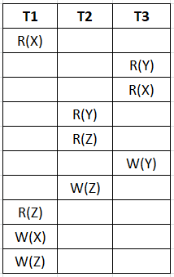
1. Conflict Serializability:
Design precedence directed graph. (nodes= number of transactions.)
check conflict pairs in other transactions and draw edges.
Conflict pairs: R(a) – W(a), W(a) – R(a), W(a) – W(a)
If no loop / no cycle in graph then schedule is conflict serializable.
If loop: non answerable
If graph is conflict serializable then schedule is serializable and consistent.

Slide 103
Conflict Serializability:
Design precedence directed graph. (nodes= number of transactions.)
check conflict pairs in other transactions and draw edges.
Conflict pairs: R-W, W-R, W-W
If no loop / no cycle in graph then schedule is conflict serializable.
If graph is conflict serializable then schedule is serializable and consistent.
Check for Indegree= 0
T2- T3- T1
T1
T2
T3

Slide 104
View Serializability:
If cycle in graph then conflict method can not find whether it is serializable or not. At that time we use view method.
If a non-serial schedule is view equivalent to some other serial schedule then the schedule is called View Serializable Schedule. It is needed to ensure the consistency of a schedule.
The two conditions needed by schedules (S1 and S2) to be view equivalent are:
Initial read must be on the same piece of data.
Example: If transaction t1 is reading "A" from database in schedule S1, then in schedule S2, t1 must read A.
2. Final write must be on the same piece of data.
Example: If a transaction t1 updated A at last in S1, then in S2, t1 should perform final write as well.
3. The mid sequence should also be in the same order.
Example: If t1 is reading A which is updated by t2 in S1, then in S2, t1 should read A which should be updated by t2.
This process of checking view equivalency of a schedule is called View Serializability

Slide 105
Benefits of Serialization
Serialization helps in checking concurrency control between multiple transactions.
It also helps in maintaining consistency in the database before and after any transaction.
Serializable schedules are resource-efficient and help in improving CPU throughput (total work done in a certain time).

Slide 106
What is Data Recovery?
It is the method of restoring the database to its correct state in the event of a failure at the time of the transaction or after the end of a process. Earlier, you have been given the concept of database recovery as a service that should be provided by all the DBMS for ensuring that the database is dependable and remains in a consistent state in the presence of failures. In this context, dependability refers to both the flexibility of the DBMS to various kinds of failure and its ability to recover from those failures.
1. Log based Recovery in DBMS
2. Shadow based Recovery in DBMS

Slide 107
Log based Recovery in DBMS
Log and log records –
The log is a sequence of log records, recording all the update activities in the database. In a stable storage, logs for each transaction are maintained. Any operation which is performed on the database is recorded is on the log. Prior to performing any modification to database, an update log record is created to reflect that modification.
An update log record represented as: <Ti, Xj, V1, V2> has these fields:
Transaction identifier: Unique Identifier of the transaction that performed the write operation.
Data item: Unique identifier of the data item written.
Old value: Value of data item prior to write.
New value: Value of data item after write operation.
Other type of log records are:
<Ti start>: It contains information about when a transaction Ti starts.
<Ti commit>: It contains information about when a transaction Ti commits.
<Ti abort>: It contains information about when a transaction Ti aborts.

Slide 108
Undo and Redo Operations –
Because all database modifications must be preceded by creation of log record, the system has available both the old value prior to modification of data item and new value that is to be written for data item. This allows system to perform redo and undo operations as appropriate:
Undo: using a log record sets the data item specified in log record to old value.
Redo: using a log record sets the data item specified in log record to new value.
The database can be modified using two approaches –
1. Deferred Modification Technique: If the transaction does not modify the database until it has partially committed, it is said to use deferred modification technique.
2. Immediate Modification Technique: If database modification occur while transaction is still active, it is said to use immediate modification technique.

Slide 109
Recovery using Log records –
After a system crash has occurred, the system consults the log to determine which transactions need to be redone and which need to be undone.
1. Transaction Ti needs to be undone if the log contains the record <Ti start> but does not contain either the record <Ti commit> or the record <Ti abort>.
2. Transaction Ti needs to be redone if log contains record <Ti start> and either the record <Ti commit> or the record <Ti abort>.

Slide 110
2. Shadow Paging / Shadow based Recovery in DBMS
Shadow Paging is recovery technique that is used to recover database.
In this recovery technique, database is considered as made up of fixed size of logical units of storage which are referred as pages. pages are mapped into physical blocks of storage, with help of the page table which allow one entry for each logical page of database.
This method uses two page tables named current page table and shadow page table.
The entries which are present in current page table are used to point to most recent database pages on disk. Another table i.e., Shadow page table is used when the transaction starts which is copying current page table. After this, shadow page table gets saved on disk and current page table is going to be used for transaction. Entries present in current page table may be changed during execution but in shadow page table it never get changed. After transaction, both tables become identical. This technique is also known as Cut-of-Place updating.

Slide 111
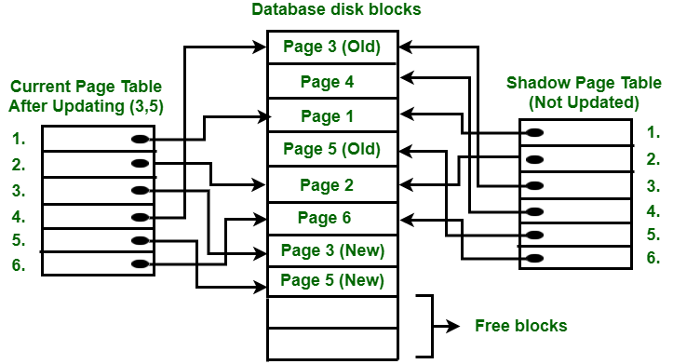
To understand concept, consider above figure. In this 2 write operations are performed on page 3 and 5. Before start of write operation on page 3, current page table points to old page 3. When write operation starts following steps are performed :
Firstly, search start for available free block in disk blocks.
After finding free block, it copies page 3 to free block which is represented by Page 3 (New).
Now current page table points to Page 3 (New) on disk but shadow page table points to old page 3 because it is not modified.
The changes are now propagated to Page 3 (New) which is pointed by current page table.

Slide 112
Advantages of Shadow Paging:
No over-head of writing log records
Recovery is trivial
Disadvantages of Shadow Paging :
Commit overhead is high
Data gets defragmented
Hard to extend algorithm to allow transaction to run concurrently.

